Slide 1
Dynamic Routing Between Capsules
ALISURE

Slide 2
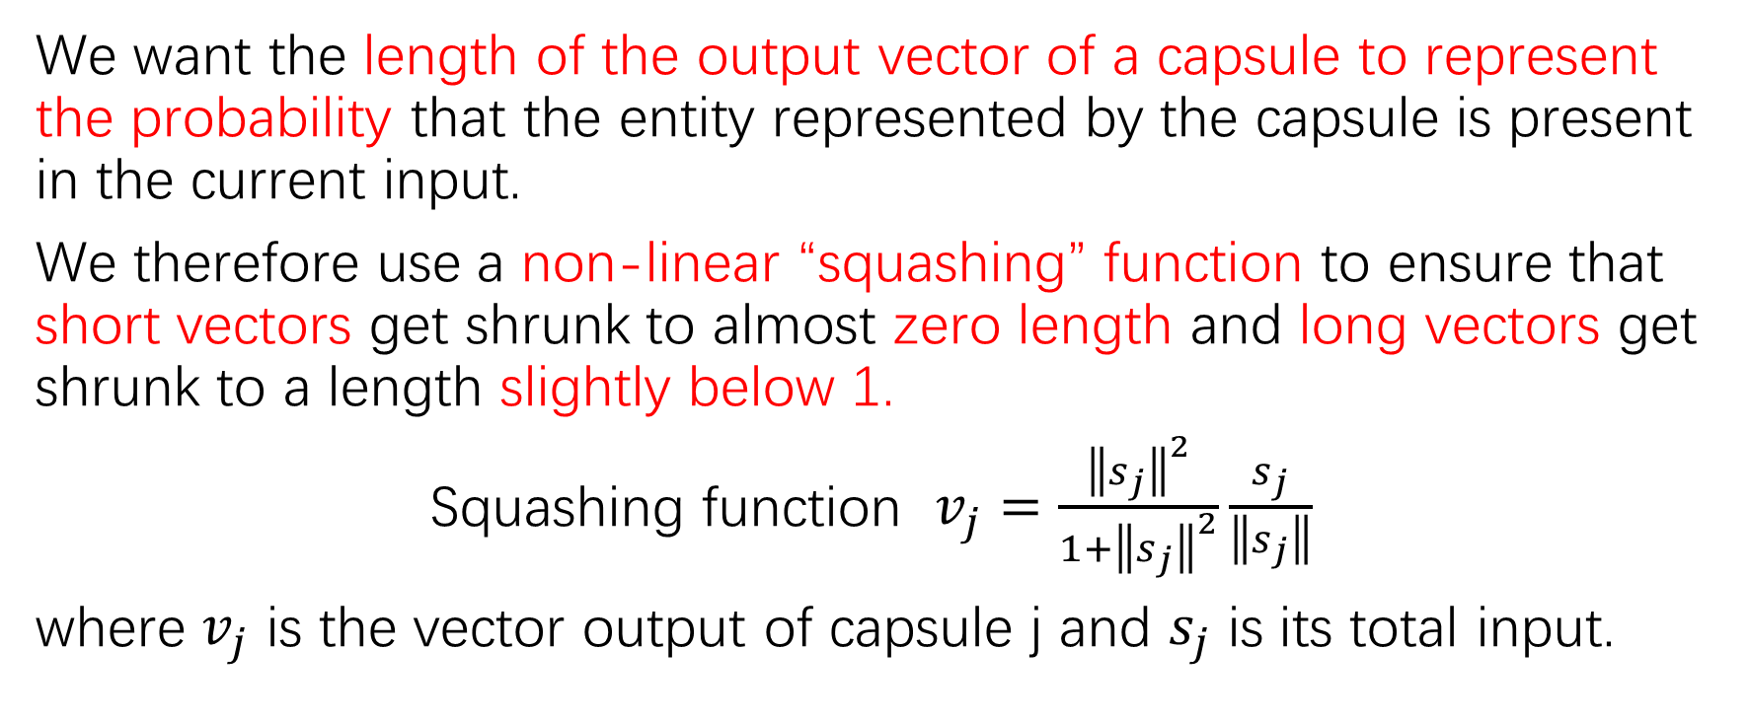
How the vector inputs and outputs of a capsule are computed
We want the length of the output vector of a capsule to represent the probability that the entity represented by the capsule is present in the current input.
We therefore use a non-linear “squashing” function to ensure that short vectors get shrunk to almost zero length and long vectors get shrunk to a length slightly below 1.
Squashing function $v_{j}=\frac{{\left\|s_{j}\right\|}^{2}}{1+{\left\|s_{j}\right\|}^{2}}\frac{s_{j}}{\left\|s_{j}\right\|}$
where $v_{j}$ is the vector output of capsule j and $s_{j}$ is its total input.

Slide 3
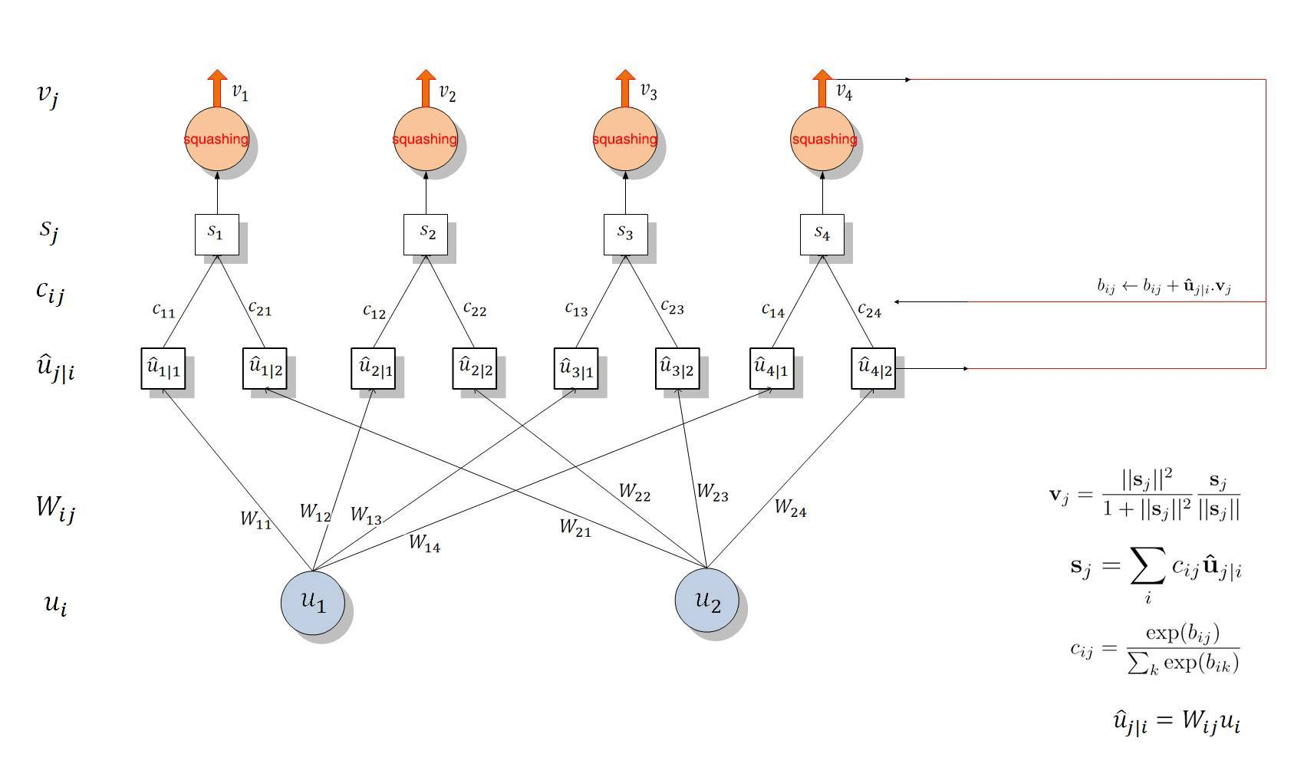
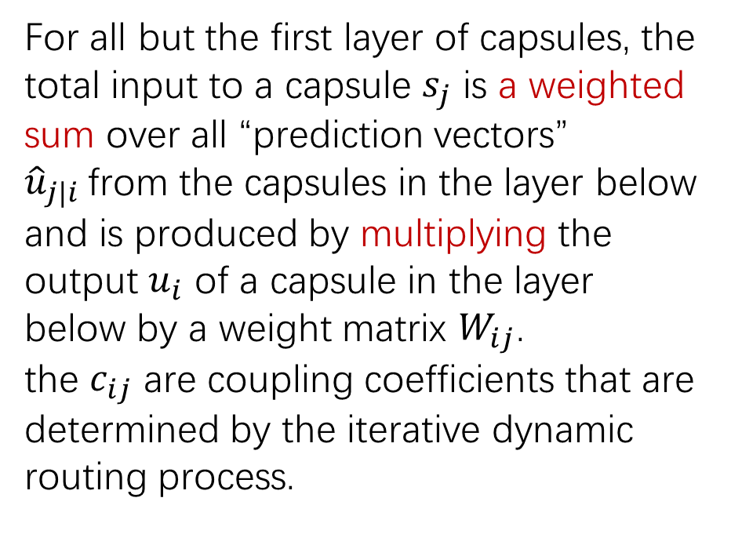


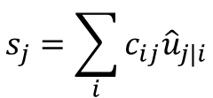
How the vector inputs and outputs of a capsule are computed
For all but the first layer of capsules, the total input to a capsule $s_{j}$ is a weighted sum over all “prediction vectors” ${\hat{u}}_{j|i}$from the capsules in the layer below and is produced by multiplying the output $u_{i}$ of a capsule in the layer below by a weight matrix $W_{ij}$.
the $c_{ij}$ are coupling coefficients that are determined by the iterative dynamic routing process.
$$s_{j}=\sum_{i}{c_{ij}{\hat{u}}_{j|i}}$$
$$c_{ij}=\frac{exp⁡(b_{ij})}{\sum_{k}{exp⁡(b_{ik})}}$$
$${\hat{u}}_{j|i}=W_{ij}u_{i}$$

Slide 4
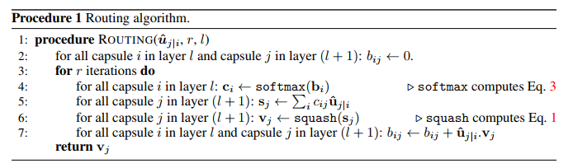
How the vector inputs and outputs of a capsule are computed

Slide 5
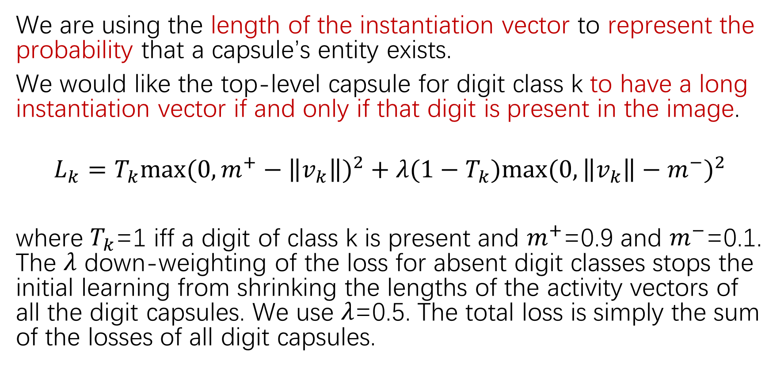
Margin loss for digit existence
We are using the length of the instantiation vector to represent the probability that a capsule’s entity exists.
We would like the top-level capsule for digit class k to have a long instantiation vector if and only if that digit is present in the image.
$$L_{k}=T_{k}{max⁡(0,m^{+}−\left\|v_{k}\right\|)}^{2}+λ(1−T_{k}){max⁡(0, \left\|v_{k}\right\|−m^{−})}^{2}$$
where $T_{k}$=1 iff a digit of class k is present and $m^{+}$=0.9 and $m^{−}$=0.1. The $λ$ down-weighting of the loss for absent digit classes stops the initial learning from shrinking the lengths of the activity vectors of all the digit capsules. We use $λ$=0.5. The total loss is simply the sum of the losses of all digit capsules.

Slide 6
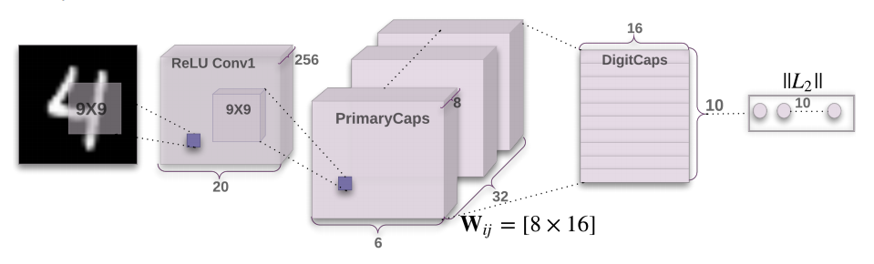
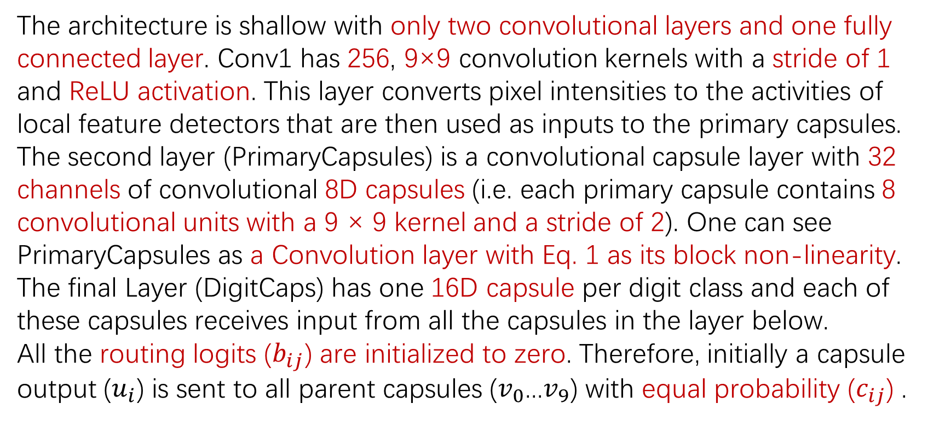
CapsNet architecture
The architecture is shallow with only two convolutional layers and one fully connected layer. Conv1 has 256, 9×9 convolution kernels with a stride of 1 and ReLU activation. This layer converts pixel intensities to the activities of local feature detectors that are then used as inputs to the primary capsules.
The second layer (PrimaryCapsules) is a convolutional capsule layer with 32 channels of convolutional 8D capsules (i.e. each primary capsule contains 8 convolutional units with a 9 × 9 kernel and a stride of 2). One can see PrimaryCapsules as a Convolution layer with Eq. 1 as its block non-linearity. The final Layer (DigitCaps) has one 16D capsule per digit class and each of these capsules receives input from all the capsules in the layer below.
All the routing logits ($b_{ij}$) are initialized to zero. Therefore, initially a capsule output ($u_{i}$) is sent to all parent capsules ($v_{0}$...$v_{9}$) with equal probability ($c_{ij}$) .

Slide 7
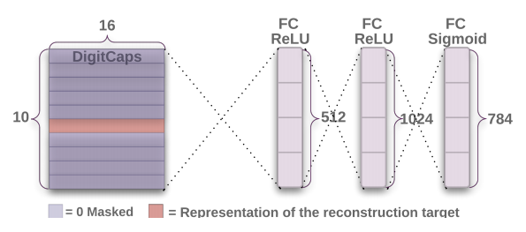
Reconstruction as a regularization method
We use an additional reconstruction loss to encourage the digit capsules to encode the instantiation parameters of the input digit. During training, we mask out all but the activity vector of the correct digit capsule. Then we use this activity vector to reconstruct the input image.
The output of the digit capsule is fed into a decoder consisting of 3 fully connected layers that model the pixel intensities. We minimize the sum of squared differences between the outputs of the logistic units and the pixel intensities. We scale down this reconstruction loss by 0.0005 so that it does not dominate the margin loss during training.

Slide 8
Capsules on MNIST
Training is performed on 28 × 28 MNIST images that have been shifted by up to 2 pixels in each direction with zero padding. No other data augmentation/deformation is used. The dataset has 60K and 10K images for training and testing respectively.
The baseline is a standard CNN with three convolutional layers of 256, 256, 128 channels. Each has 5x5 kernels and stride of 1. The last convolutional layers are followed by two fully connected layers of size 328, 192. The last fully connected layer is connected with dropout to a 10 class softmax layer with cross entropy loss. The baseline is also trained on 2-pixel shifted MNIST with Adam optimizer. The baseline is designed to achieve the best performance on MNIST while keeping the computation cost as close as to CapsNet. In terms of number of parameters the baseline has 35.4M while CapsNet has 8.2M parameters and 6.8M parameters without the reconstruction subnetwork.

Slide 9
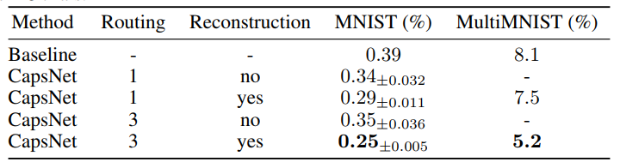
Capsules on MNIST
CapsNet classification test accuracy
Reports the test error rate on MNIST for different CapsNet setups and shows the importance of routing and reconstruction regularizer.

Slide 10
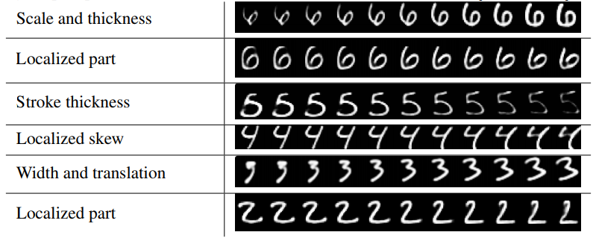
What the individual dimensions of a capsule represent
We can see what the individual dimensions represent by making use of the decoder network. After computing the activity vector for the correct digit capsule, we can feed a perturbed version of this activity vector to the decoder network and see how the perturbation affects the reconstruction. We found that one dimension (out of 16) of the capsule almost always represents the width of the digit.

